Slide 1
NT219- Cryptography
Week 3: Modern Symmetric Ciphers
PhD. Ngoc-Tu Nguyen
tunn@uit.edu.vn

Slide 2
What is cryptograph?
Cryptology= Cryptography + Cryptanalysis
Goals
What?
Cipher systems
- Sysmmetric (AES)
- Asymmetric (RSA, ECC, CRYSTALS-KYBER)
Confidentiality
Privacy
Integrity
Hash functions
Message authentication code (MAC)
Digital signature (digital certificate)
Authentication
Non-repudiation (Accountability)
Availability

Slide 3
Cryptanalysis on monoalphabetic cipher?
hzsrnqc klyy wqc flo mflwf ol zqdn nsoznj wskn lj xzsrbjnf, wzsxz gqv zqhhnf ol ozn glco zlfnco hnlhrn; nsoznj jnrqosdnc lj fnqj kjsnfbc, wzsxz sc xnjoqsfrv gljn efeceqr. zn rsdnb qrlfn sf zsc zlecn sf cqdsrrn jlw, wzsoznj flfn hnfnojqonb. q csfyrn blgncosx cekksxnb ol cnjdn zsg. zn pjnqmkqconb qfb bsfnb qo ozn xrep, qo zlejc gqozngqosxqrrv ksanb, sf ozn cqgn jllg, qo ozn cqgn oqprn, fndnj oqmsfy zsc gnqrc wsoz loznj gngpnjc, gexz rncc pjsfysfy q yenco wsoz zsg; qfb wnfo zlgn qo naqxorv gsbfsyzo, lfrv ol jnosjn qo lfxn ol pnb. zn fndnj ecnb ozn xlcv xzqgpnjc wzsxz ozn jnkljg hjldsbnc klj soc kqdlejnb gngpnjc. zn hqccnb onf zlejc leo lk ozn ownfov-klej sf cqdsrrn jlw, nsoznj sf crnnhsfy lj gqmsfy zsc olsrno.

Slide 4
Outline
Classical cipher algorithms (review)
Stream Cipher
Block cipher
Data Encryption Standard (DES)
Advanced Encryption Standard (AES)
Some other ciphers
Searchable encryption
Notes:
Cipher=a secret system of writing;

Slide 5
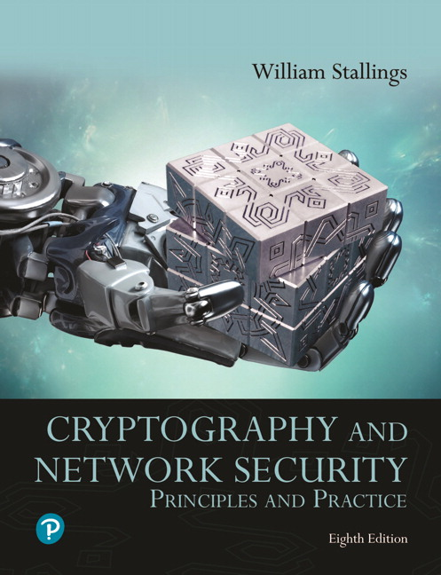

Textbooks and References
Text books
[1] Chapter 4,6
[2] Chapter 5

Slide 6
Classical cipher algorithms
Substitution Technique
Monoalphabetic cipher
Replace one character by another character
Polyalphabetic cipher
Replace some characters by other characters
2 by 2:
3 by 3:
Transposition Technique
Keep the same scource characters bat change their positions
Notes:
The two basic building blocks of all encryption techniques are substitution
and transposition. We examine these in the next two sections. Finally, we discuss a
system that combines both substitution and transposition.
A substitution technique is one in which the letters of plaintext are replaced by
other letters or by numbers or symbols. If the plaintext is viewed as a sequence of bits,
then substitution involves replacing plaintext bit patterns with ciphertext bit patterns.

Slide 7

(1) Caesar Cipher (replace 1 character by 1 one character )
Monoalphabetic cipher
Simplest and earliest known use of a substitution cipher
Used by Julius Caesar
Key
plain: MEET ME AFTER THE TOGA PARTY
cipher: JBBQ JB XCQBO QEB QLDX MXOQV
Notes:
The earliest known, and the simplest, use of a substitution cipher was by Julius
Caesar. The Caesar cipher involves replacing each letter of the alphabet with the
letter standing three places further down the alphabet.

Slide 8
Monoalphabetic cipher
(2) Generral Monoalphabetic substitution
EX:
MEET ME AT OUR SPOT
DTTM DT AM GWK LHGM
If the “cipher” line can be any permutation of the 26 alphabetic characters, then there are 26! or greater than 4 x 10²⁶ possible keys
This is 10 orders of magnitude greater than the key space for DES
Notes:
With only 25 possible keys, the Caesar cipher is far from secure. A dramatic increase
in the key space can be achieved by allowing an arbitrary substitution. Before proceeding,
we define the term permutation . A permutation of a finite set of elements S
is an ordered sequence of all the elements of S, with each element appearing exactly
once.
For example, if S = {a, b, c}, there are six permutations of S :
abc, acb, bac, bca, cab, cba
In general, there are n ! permutations of a set of n elements, because the first
element can be chosen in one of n ways, the second in n - 1 ways, the third in n - 2
ways, and so on.
If, instead, the “cipher” line can be any permutation of the 26 alphabetic characters,
then there are 26! or greater than 4 * 10²⁶ possible keys. This is 10 orders of magnitude
greater than the key space for DES and would seem to eliminate brute-force
techniques for cryptanalysis. Such an approach is referred to as a monoalphabetic
substitution cipher, because a single cipher alphabet (mapping from plain alphabet
to cipher alphabet) is used per message.

Slide 9
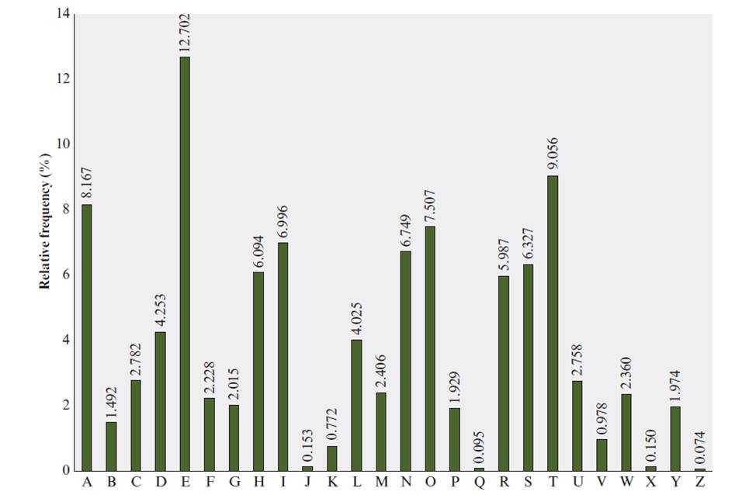
Relative Frequency of Letters in English Text
Notes:
There is, however, another line of attack. If the cryptanalyst knows the nature
of the plaintext (e.g., noncompressed English text), then the analyst can exploit the
regularities of the language. To see how such a cryptanalysis might proceed, we give
a partial example here that is adapted from one in [SINK09]. The ciphertext to be
solved is
UZQSOVUOHXMOPVGPOZPEVSGZWSZOPFPESXUDBMETSXAIZ
VUEPHZHMDZSHZOWSFPAPPDTSVPQUZWYMXUZUHSX
EPYEPOPDZSZUFPOMBZWPFUPZHMDJUDTMOHMQ
As a first step, the relative frequency of the letters can be determined and
compared to a standard frequency distribution for English, such as is shown in
Figure 3.5 (based on [LEWA00]). If the message were long enough, this technique
alone might be sufficient, but because this is a relatively short message, we cannot
expect an exact match. In any case, the relative frequencies of the letters in the
ciphertext (in percentages) are as follows:
P 13.33 H 5.83 F 3.33 B 1.67 C 0.00
Z 11.67 D 5.00 W 3.33 G 1.67 K 0.00
S 8.33 E 5.00 Q 2.50 Y 1.67 L 0.00
U 8.33 V 4.17 T 2.50 I 0.83 N 0.00
O 7.50 X 4.17 A 1.67 J 0.83 R 0.00
M 6.67
Comparing this breakdown with Figure 3.5, it seems likely that cipher letters P
and Z are the equivalents of plain letters e and t, but it is not certain which is which.
The letters S, U, O, M, and H are all of relatively high frequency and probably correspond
to plain letters from the set {a, h, i, n, o, r, s}. The letters with the lowest
frequencies (namely, A, B, G, Y, I, J) are likely included in the set {b, j, k, q, v, x, z}.
There are a number of ways to proceed at this point. We could make some tentative
assignments and start to fill in the plaintext to see if it looks like a reasonable
“skeleton” of a message. A more systematic approach is to look for other regularities.
For example, certain words may be known to be in the text. Or we could look for
repeating sequences of cipher letters and try to deduce their plaintext equivalents.

Slide 10
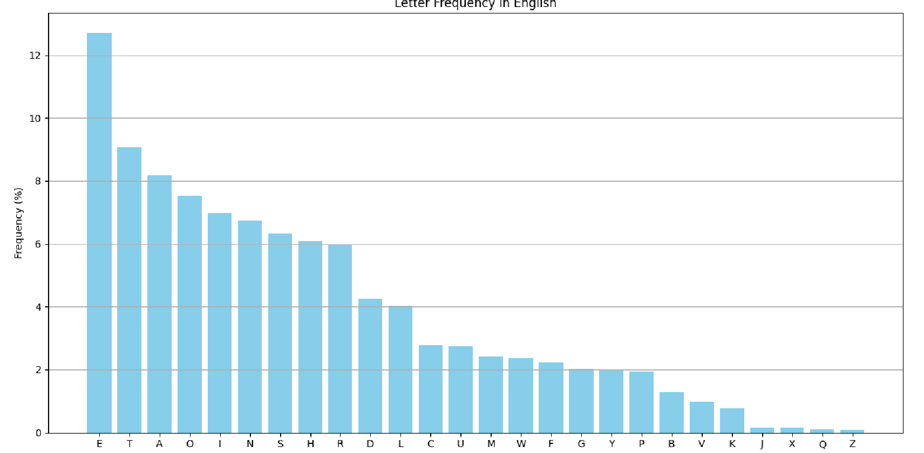
Relative Frequency of Letters in English Text

Slide 11
Cryptanalysis on monoalphabetic cipher
hzsrnqc klyy wqc flo mflwf ol zqdn nsoznj wskn lj xzsrbjnf, wzsxz gqv zqhhnf ol ozn glco zlfnco hnlhrn; nsoznj jnrqosdnc lj fnqj kjsnfbc, wzsxz sc xnjoqsfrv gljn efeceqr. zn rsdnb qrlfn sf zsc zlecn sf cqdsrrn jlw, wzsoznj flfn hnfnojqonb. q csfyrn blgncosx cekksxnb ol cnjdn zsg. zn pjnqmkqconb qfb bsfnb qo ozn xrep, qo zlejc gqozngqosxqrrv ksanb, sf ozn cqgn jllg, qo ozn cqgn oqprn, fndnj oqmsfy zsc gnqrc wsoz loznj gngpnjc, gexz rncc pjsfysfy q yenco wsoz zsg; qfb wnfo zlgn qo naqxorv gsbfsyzo, lfrv ol jnosjn qo lfxn ol pnb. zn fndnj ecnb ozn xlcv xzqgpnjc wzsxz ozn jnkljg hjldsbnc klj soc kqdlejnb gngpnjc. zn hqccnb onf zlejc leo lk ozn ownfov-klej sf cqdsrrn jlw, nsoznj sf crnnhsfy lj gqmsfy zsc olsrno.

Slide 12
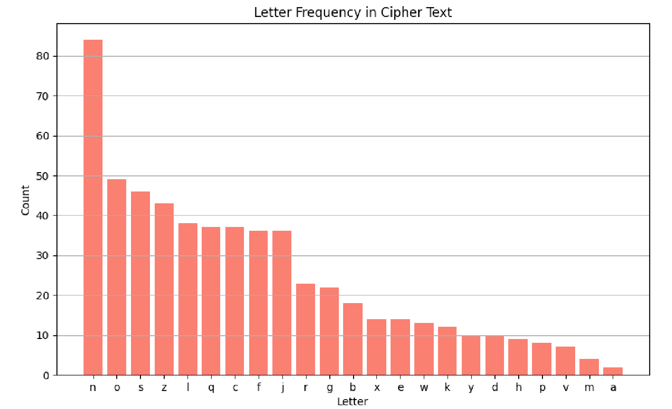
Cryptanalysis on monoalphabetic cipher

Slide 13

Polyalphabetic Cipher
Polyalphabetic Cipher is a substitution cipher in which the cipher alphabet for the plain alphabet may be different at different places during the encryption process;
Playfair Cipher: replace 2 characters by 2 characters
Hill Cipher: replace 3 characters by 3 characters
Vigenere Cipher

Slide 14
Playfair encryption
+1
M | O | N | A | R
C | H | Y | B | D
E | F | G | I/J | K
L | P | Q | S | T
U | V | W | X | Z
Key matrix
+1
Plaintext: "Hide the gold in the tree stump"
Plaintext diagram:
HI DE TH EG OL DI NT HE TR EX ES TU MP
Ciphertext diagram:
BF CK PD FI .. .. .. .. ZD
https://en.wikipedia.org/wiki/Playfair_cipher
Notes:
In this case, the keyword is monarchy . The matrix is constructed by filling
in the letters of the keyword (minus duplicates) from left to right and from top to
bottom, and then filling in the remainder of the matrix with the remaining letters in
alphabetic order. The letters I and J count as one letter. Plaintext is encrypted two
letters at a time, according to the following rules:
1. Repeating plaintext letters that are in the same pair are separated with a filler
letter, such as x, so that balloon would be treated as ba lx lo on.
2. Two plaintext letters that fall in the same row of the matrix are each replaced
by the letter to the right, with the first element of the row circularly following
the last. For example, ar is encrypted as RM.
3. Two plaintext letters that fall in the same column are each replaced by the
letter beneath, with the top element of the column circularly following the last.
For example, mu is encrypted as CM.
4. Otherwise, each plaintext letter in a pair is replaced by the letter that lies in
its own row and the column occupied by the other plaintext letter. Thus, hs
becomes BP and ea becomes IM (or JM, as the encipherer wishes).
The Playfair cipher is a great advance over simple monoalphabetic ciphers.
For one thing, whereas there are only 26 letters, there are 26 * 26 = 676 digrams, so
that identification of individual digrams is more difficult. Furthermore, the relative
frequencies of individual letters exhibit a much greater range than that of digrams,
making frequency analysis much more difficult. For these reasons, the Playfair
cipher was for a long time considered unbreakable. It was used as the standard field
system by the British Army in World War I and still enjoyed considerable use by the
U.S. Army and other Allied forces during World War II.
Despite this level of confidence in its security, the Playfair cipher is relatively
easy to break, because it still leaves much of the structure of the plaintext language
intact. A few hundred letters of ciphertext are generally sufficient.

Slide 15
(4) Hill Cipher
Polyalphabetic Cipher
Developed by the mathematician Lester Hill in 1929
Strength is that it completely hides single-letter frequencies
The use of a larger matrix hides more frequency information
A 3 x 3 Hill cipher hides not only single-letter but also two-letter frequency information
Strong against a ciphertext-only attack but easily broken with a known plaintext attack
Notes:
Another interesting multiletter cipher is the Hill cipher, developed by the mathematician
Lester Hill in 1929.
Before describing the Hill cipher, let us briefly
review some terminology from linear algebra. In this discussion, we are concerned
with matrix arithmetic modulo 26. For the reader who needs a refresher on matrix
multiplication and inversion, see Appendix A.
We define the inverse M⁻¹ of a square matrix M by the equation
M (M⁻¹ ) = M⁻¹M = I , where I is the identity matrix. I is a square matrix that is all
zeros except for ones along the main diagonal from upper left to lower right. The
inverse of a matrix does not always exist, but when it does, it satisfies the preceding
equation.
To explain how the inverse of a matrix is computed, we begin with the concept
of determinant. For any square matrix (m * m ), the determinant equals the sum of
all the products that can be formed by taking exactly one element from each row
and exactly one element from each column, with certain of the product terms preceded
by a minus sign.
This encryption algorithm takes m successive plaintext letters
and substitutes for them m ciphertext letters. The substitution is determined
by m linear equations in which each character is assigned a numerical value
(a = 0, b = 1, …. , z = 25).
As with Playfair, the strength of the Hill cipher is that it completely hides
single-letter frequencies. Indeed, with Hill, the use of a larger matrix hides more
frequency information. Thus, a 3 * 3 Hill cipher hides not only single-letter but
also two-letter frequency information.
Although the Hill cipher is strong against a ciphertext-only attack, it is
easily broken with a known plaintext attack.

Slide 16




Polyalphabetic Cipher
Cryptoanalys Playfair cipher
Digram
Two-letter combination
Most common is th
Trigram
Three-letter combination
Most frequent is the
Notes:
A powerful tool is to look at the frequency of two-letter combinations, known
as digrams . A table similar to Figure 3.5 could be drawn up showing the relative frequency
of digrams. The most common such digram is th. In our ciphertext, the most
common digram is ZW, which appears three times. So we make the correspondence
of Z with t and W with h. Then, by our earlier hypothesis, we can equate P with e.
Now notice that the sequence ZWP appears in the ciphertext, and we can translate
that sequence as “the.” This is the most frequent trigram (three-letter combination)
in English, which seems to indicate that we are on the right track.
Next, notice the sequence ZWSZ in the first line. We do not know that these
four letters form a complete word, but if they do, it is of the form th_t. If so, S
equates with a.
So far, then, we have
UZQSOVUOHXMOPVGPOZPEVSGZWSZOPFPESXUDBMETSXAIZ
t a e e te a that e e a a
VUEPHZHMDZSHZOWSFPAPPDTSVPQUZWYMXUZUHSX
e t ta t ha e ee a e th t a
EPYEPOPDZSZUFPOMBZWPFUPZHMDJUDTMOHMQ
e e e tat e the t
Only four letters have been identified, but already we have quite a bit of the
message. Continued analysis of frequencies plus trial and error should easily yield a
solution from this point. The complete plaintext, with spaces added between words,
follows:
it was disclosed yesterday that several informal but
direct contacts have been made with political
representatives of the Viet cong in Moscow
Monoalphabetic ciphers are easy to break because they reflect the frequency
data of the original alphabet. A countermeasure is to provide multiple substitutes,
known as homophones, for a single letter. For example, the letter e could be assigned
a number of different cipher symbols, such as 16, 74, 35, and 21, with each
homophone assigned to a letter in rotation or randomly. If the number of symbols
assigned to each letter is proportional to the relative frequency of that letter, then
single-letter frequency information is completely obliterated. The great mathematician
Carl Friedrich Gauss believed that he had devised an unbreakable cipher using
homophones. However, even with homophones, each element of plaintext affects
only one element of ciphertext, and multiple-letter patterns (e.g., digram frequencies)
still survive in the ciphertext, making cryptanalysis relatively straightforward.
Two principal methods are used in substitution ciphers to lessen the extent to
which the structure of the plaintext survives in the ciphertext: One approach is to
encrypt multiple letters of plaintext, and the other is to use multiple cipher alphabets.
We briefly examine each.

Slide 17
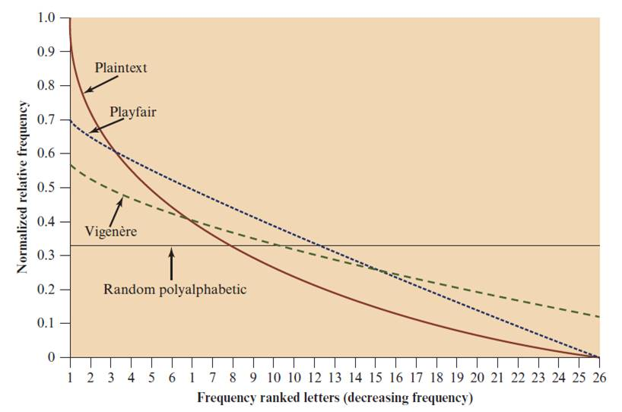
Classical symmetric cipher cryptanalysis
Notes:
One way of revealing the effectiveness of the Playfair and other ciphers
is shown in Figure 3.6. The line labeled plaintext plots a typical frequency
distribution of the 26 alphabetic characters (no distinction between upper
and lower case) in ordinary text. This is also the frequency distribution of any
monoalphabetic substitution cipher, because the frequency values for individual
letters are the same, just with different letters substituted for the original letters.
The plot is developed in the following way: The number of occurrences of each
letter in the text is counted and divided by the number of occurrences of the
most frequently used letter. Using the results of Figure 3.5, we see that
e is the most frequently used letter. As a result, e has a relative frequency of 1, t of
9.056/12.702 0.72, and so on. The points on the horizontal axis correspond
to the letters in order of decreasing frequency.
Figure 3.6 also shows the frequency distribution that results when the text
is encrypted using the Playfair cipher. To normalize the plot, the number of
occurrences of each letter in the ciphertext was again divided by the number of
occurrences of e in the plaintext. The resulting plot therefore shows the extent
to which the frequency distribution of letters, which makes it trivial to solve
substitution ciphers, is masked by encryption. If the frequency distribution
information were totally concealed in the encryption process, the ciphertext plot
of frequencies would be flat, and cryptanalysis using ciphertext only would be
effectively impossible. As the figure shows, the Playfair cipher has a flatter distribution
than does plaintext, but nevertheless, it reveals plenty of structure for
a cryptanalyst to work with. The plot also shows the Vigenère cipher, discussed
subsequently. The Hill and Vigenère curves on the plot are based on results
reported in [SIMM93].

Slide 18
(5) Vigenère Cipher
Polyalphabetic Cipher
Best known and one of the simplest polyalphabetic substitution ciphers
In this scheme the set of related monoalphabetic substitution rules consists of the 26 Caesar ciphers with shifts of 0 through 25
Each cipher is denoted by a key letter which is the ciphertext letter that substitutes for the plaintext letter a
https://en.wikipedia.org/wiki/Vigen%C3%A8re_cipher
Notes:
The best known, and one of the simplest, polyalphabetic ciphers
is the Vigenère cipher. In this scheme, the set of related monoalphabetic substitution
rules consists of the 26 Caesar ciphers with shifts of 0 through 25. Each cipher is
denoted by a key letter, which is the ciphertext letter that substitutes for the plaintext
letter a. Thus, a Caesar cipher with a shift of 3 is denoted by the key value 3.

Slide 19
Example of Vigenère Cipher
To encrypt a message, a key is needed that is as long as the message
Usually, the key is a repeating keyword
For example, if the keyword is deceptive, the message “we are discovered save yourself” is encrypted as:
plaintext: wearediscoveredsaveyourself
key: deceptivedeceptivedeceptive
ciphertext: ??
Notes:
To encrypt a message, a key is needed that is as long as the message. Usually,
the key is a repeating keyword. For example, if the keyword is deceptive, the
message “we are discovered save yourself” is encrypted as
key: deceptivedeceptivedeceptive
plaintext: wearediscoveredsaveyourself
ciphertext: ZICVTWQNGRZGVTWAVZHCQYGLMGJ
The strength of this cipher is that there are multiple ciphertext letters for
each plaintext letter, one for each unique letter of the keyword. Thus, the letter
frequency information is obscured. However, not all knowledge of the plaintext
structure is lost. For example, Figure 3.6 shows the frequency distribution for a
Vigenère cipher with a keyword of length 9. An improvement is achieved over the
Playfair cipher, but considerable frequency information remains.

Slide 20
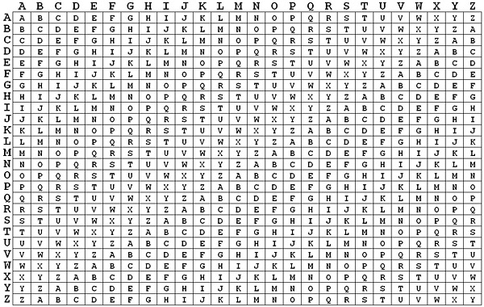
Vigenère Cipher
Vigenère matrix
Notes:
The best known, and one of the simplest, polyalphabetic ciphers
is the Vigenère cipher. In this scheme, the set of related monoalphabetic substitution
rules consists of the 26 Caesar ciphers with shifts of 0 through 25. Each cipher is
denoted by a key letter, which is the ciphertext letter that substitutes for the plaintext
letter a. Thus, a Caesar cipher with a shift of 3 is denoted by the key value 3.

Slide 21
Vigenère Autokey System
Example:
key: deceptivewearediscoveredsav
plaintext: wearediscoveredsaveyourself
ciphertext: ZICVTWQNGKZEIIGASXSTSLVVWLA
Even this scheme is vulnerable to cryptanalysis
Because the key and the plaintext share the same frequency distribution of letters, a statistical technique can be applied
Notes:
The periodic nature of the keyword can be eliminated by using a nonrepeating
keyword that is as long as the message itself. Vigenère proposed what is referred to
as an autokey system , in which a keyword is concatenated with the plaintext itself to
provide a running key. For our example,
key: deceptivewearediscoveredsav
plaintext: wearediscoveredsaveyourself
ciphertext: ZICVTWQNGKZEIIGASXSTSLVVWLA
Even this scheme is vulnerable to cryptanalysis. Because the key and the
plaintext share the same frequency distribution of letters, a statistical technique
can be applied. For example, e enciphered by e , by Figure 3.5, can be expected to
occur with a frequency of (0.127⁾² = 0.016, whereas t enciphered by t would occur
only about half as often. These regularities can be exploited to achieve successful
cryptanalysis.

Slide 22
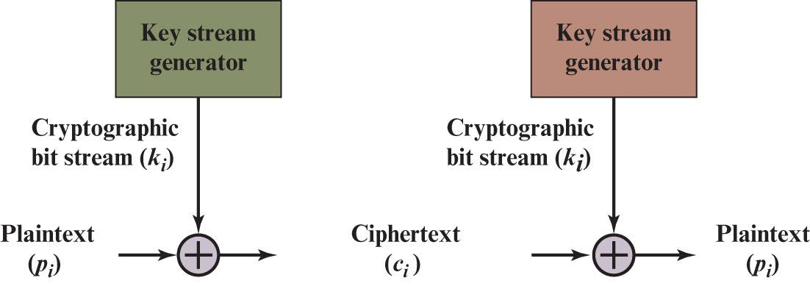
(6) Vernam Cipher
Stream ciper
https://en.wikipedia.org/wiki/Gilbert_Vernam
Notes:
The ultimate defense against such a cryptanalysis is to choose a
keyword that is as long as the plaintext and has no statistical relationship to it. Such
a system was introduced by an AT&T engineer named Gilbert Vernam in 1918.
His system works on binary data (bits) rather than letters.
The essence of this technique is the means of construction of the key. Vernam
proposed the use of a running loop of tape that eventually repeated the key, so
that in fact the system worked with a very long but repeating keyword. Although
such a scheme, with a long key, presents formidable cryptanalytic difficulties, it
can be broken with sufficient ciphertext, the use of known or probable plaintext
sequences, or both.

Slide 23

One-Time Pad
Improvement to Vernam cipher proposed by an Army Signal Corp officer, Joseph Mauborgne
Use a random key that is as long as the message so that the key need not be repeated
Key is used to encrypt and decrypt a single message and then is discarded
Each new message requires a new key of the same length as the new message
Scheme is unbreakable
Produces random output that bears no statistical relationship to the plaintext
Because the ciphertext contains no information whatsoever about the plaintext, there is simply no way to break the code
Notes:
An Army Signal Corp officer, Joseph Mauborgne, proposed an improvement to the
Vernam cipher that yields the ultimate in security. Mauborgne suggested using a
random key that is as long as the message, so that the key need not be repeated. In
addition, the key is to be used to encrypt and decrypt a single message, and then is
discarded. Each new message requires a new key of the same length as the new message.
Such a scheme, known as a one-time pad , is unbreakable. It produces random
output that bears no statistical relationship to the plaintext. Because the ciphertext
contains no information whatsoever about the plaintext, there is simply no way to
break the code.
In fact, given any plaintext of equal length to the ciphertext, there is a key that
produces that plaintext. Therefore, if you did an exhaustive search of all possible
keys, you would end up with many legible plaintexts, with no way of knowing which
was the intended plaintext. Therefore, the code is unbreakable.
The security of the one-time pad is entirely due to the randomness of
the key. If the stream of characters that constitute the key is truly random, then the
stream of characters that constitute the ciphertext will be truly random. Thus, there
are no patterns or regularities that a cryptanalyst can use to attack the ciphertext.

Slide 24
Difficulties
The one-time pad offers complete security but, in practice, has two fundamental difficulties:
There is the practical problem of making large quantities of random keys
Any heavily used system might require millions of random characters on a regular basis
Mammoth key distribution problem
For every message to be sent, a key of equal length is needed by both sender and receiver
Because of these difficulties, the one-time pad is of limited utility
Useful primarily for low-bandwidth channels requiring very high security
The one-time pad is the only cryptosystem that exhibits perfect secrecy (see Appendix F)
Notes:
In theory, we need look no further for a cipher. The one-time pad offers complete
security but, in practice, has two fundamental difficulties:
1. There is the practical problem of making large quantities of random keys.
Any heavily used system might require millions of random characters
on a regular basis. Supplying truly random characters in this volume is a
significant task.
2. Even more daunting is the problem of key distribution and protection. For
every message to be sent, a key of equal length is needed by both sender and
receiver. Thus, a mammoth key distribution problem exists.
Because of these difficulties, the one-time pad is of limited utility and is useful
primarily for low-bandwidth channels requiring very high security.
The one-time pad is the only cryptosystem that exhibits what is referred to as
perfect secrecy . This concept is explored in Appendix B.

Slide 25
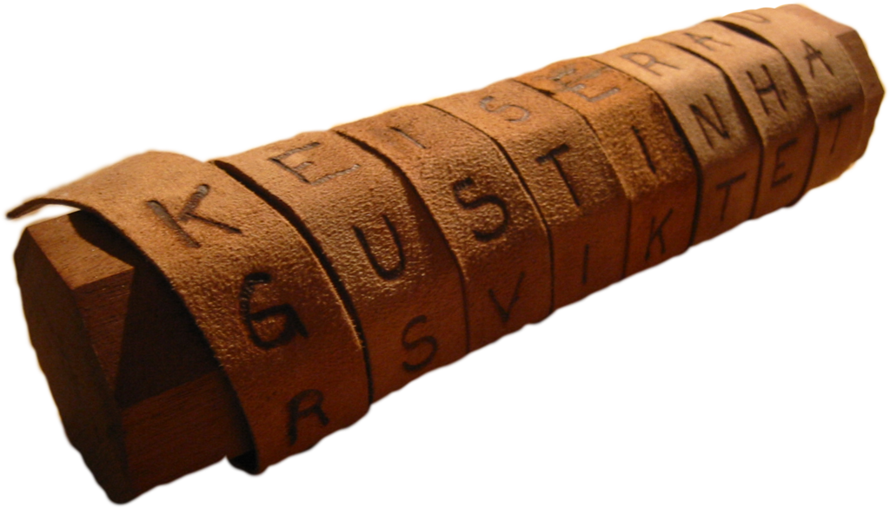
Transposition ciphers
Goals: scrambles the positions of characters
(1) Rail fence cipher
(2) Columnar Transposition Cipher
https://en.wikipedia.org/wiki/Transposition_cipher
Notes:
All the techniques examined so far involve the substitution of a ciphertext symbol
for a plaintext symbol. A very different kind of mapping is achieved by performing
some sort of permutation on the plaintext letters. This technique is referred to as a
transposition cipher.
The simplest such cipher is the rail fence technique, in which the plaintext is
written down as a sequence of diagonals and then read off as a sequence of rows.
For example, to encipher the message “meet me after the toga party” with a rail
fence of depth 2, we write the following:
m e m a t r h t g p r y
e t e f e t e o a a t
The encrypted message is
MEMATRHTGPRYETEFETEOAAT

Slide 26
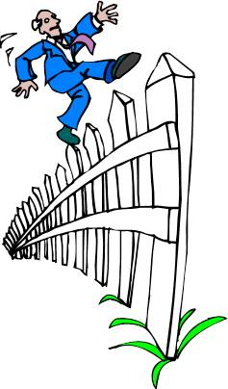
Transposition cipher
(1) Rail fence cipher
Simplest transposition cipher
Plaintext is written down as a sequence of diagonals and then read off as a sequence of rows
To encipher the message “meet me after the toga party” with a rail fence of depth 2, we would write:
Ciphertext
Encrypted message is:
MEMATRHTGPRYETEFETEOAAT
https://en.wikipedia.org/wiki/Rail_fence_cipher
Notes:
All the techniques examined so far involve the substitution of a ciphertext symbol
for a plaintext symbol. A very different kind of mapping is achieved by performing
some sort of permutation on the plaintext letters. This technique is referred to as a
transposition cipher.
The simplest such cipher is the rail fence technique, in which the plaintext is
written down as a sequence of diagonals and then read off as a sequence of rows.
For example, to encipher the message “meet me after the toga party” with a rail
fence of depth 2, we write the following:
m e m a t r h t g p r y
e t e f e t e o a a t
The encrypted message is
MEMATRHTGPRYETEFETEOAAT

Slide 27
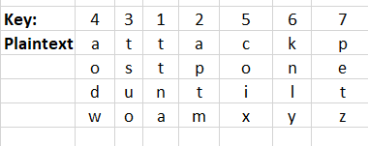
Columnar Transposition Cipher
Is a more complex transposition
Write the message in a rectangle, row by row, and read the message off, column by column, but permute the order of the columns
The order of the columns then becomes the key to the algorithm
Ciphertext
Ciphertext: TTNAAPTMTSUOAODWCOIXKNLYPETZ
Notes:
A more complex scheme is
to write the message in a rectangle, row by row, and read the message off, column
by column, but permute the order of the columns. The order of the columns then
becomes the key to the algorithm. For example,
Key: 4 3 1 2 5 6 7
Plaintext: a t t a c k p
o s t p o n e
d u n t i l t
w o a m x y z
Ciphertext: TTNAAPTMTSUOAODWCOIXKNLYPETZ
Thus, in this example, the key is 4312567. To encrypt, start with the column
that is labeled 1, in this case column 3. Write down all the letters in that column.
Proceed to column 4, which is labeled 2, then column 2, then column 1, then
columns 5, 6, and 7.
A pure transposition cipher is easily recognized because it has the same letter
frequencies as the original plaintext. For the type of columnar transposition just
shown, cryptanalysis is fairly straightforward and involves laying out the ciphertext
in a matrix and playing around with column positions. Digram and trigram
frequency tables can be useful.
The transposition cipher can be made significantly more secure by performing
more than one stage of transposition. The result is a more complex permutation
that is not easily reconstructed.

Slide 28
Classical symmetric cipher cryptanalysis
Notes:
One way of revealing the effectiveness of the Playfair and other ciphers
is shown in Figure 3.6. The line labeled plaintext plots a typical frequency
distribution of the 26 alphabetic characters (no distinction between upper
and lower case) in ordinary text. This is also the frequency distribution of any
monoalphabetic substitution cipher, because the frequency values for individual
letters are the same, just with different letters substituted for the original letters.
The plot is developed in the following way: The number of occurrences of each
letter in the text is counted and divided by the number of occurrences of the
most frequently used letter. Using the results of Figure 3.5, we see that
e is the most frequently used letter. As a result, e has a relative frequency of 1, t of
9.056/12.702 0.72, and so on. The points on the horizontal axis correspond
to the letters in order of decreasing frequency.
Figure 3.6 also shows the frequency distribution that results when the text
is encrypted using the Playfair cipher. To normalize the plot, the number of
occurrences of each letter in the ciphertext was again divided by the number of
occurrences of e in the plaintext. The resulting plot therefore shows the extent
to which the frequency distribution of letters, which makes it trivial to solve
substitution ciphers, is masked by encryption. If the frequency distribution
information were totally concealed in the encryption process, the ciphertext plot
of frequencies would be flat, and cryptanalysis using ciphertext only would be
effectively impossible. As the figure shows, the Playfair cipher has a flatter distribution
than does plaintext, but nevertheless, it reveals plenty of structure for
a cryptanalyst to work with. The plot also shows the Vigenère cipher, discussed
subsequently. The Hill and Vigenère curves on the plot are based on results
reported in [SIMM93].

Slide 29





Stream Cipher (1 of 8)
Secret key (Keystream)
Plaintext stream
$$k1$$ | $$k2$$ | $$k3$$ | $$…$$ | $$k_{n}$$
$$m1$$ | $$m2$$ | $$m3$$ | $$…$$ | $$m_{n}$$
bit or byte
Ciphertext
$$k1⨁m1$$ | $$k2⨁m2$$ | $$…$$ | $${k_{n}⨁m}_{n}$$
where
Notes:
A stream cipher is one that encrypts a digital data stream one bit or one byte at a time. Examples of classical stream ciphers are the autokeyed Vigenère cipher and the Vernam cipher. In the ideal case, a one-time pad version of the Vernam cipher would be used (Figure 3.7), in which the keystream (k_{i} ) is as long as the plaintext bit stream (p_{i} ). If the cryptographic keystream is random, then this cipher is unbreakable by any means other than acquiring the keystream. However, the keystream must be provided to both users in advance via some independent and secure channel. This introduces insurmountable logistical problems if the intended data traffic is very large.
Accordingly, for practical reasons, the bit-stream generator must be implemented as an algorithmic procedure, so that the cryptographic bit stream
can be produced by both users. In this approach (Figure 4.1a), the bit-stream generator is a key-controlled algorithm and must produce a bit stream that is cryptographically strong. That is, it must be computationally impractical to predict future portions of the bit stream based on previous portions of the bit stream. The two users need only share the generating key, and each can produce the keystream.

Slide 30



Stream Cipher (2 of 8)
Vigenère cipher
Plaintext stream
Secret key (Keystream)
Ciphertext
where
Notes:
A stream cipher is one that encrypts a digital data stream one bit or one byte at
a time. Examples of classical stream ciphers are the autokeyed Vigenère cipher
and the Vernam cipher. In the ideal case, a one-time pad version of the Vernam
cipher would be used (Figure 3.7), in which the keystream (k_{i} ) is as long as the
plaintext bit stream (p_{i} ). If the cryptographic keystream is random, then this cipher
is unbreakable by any means other than acquiring the keystream. However, the
keystream must be provided to both users in advance via some independent and
secure channel. This introduces insurmountable logistical problems if the intended
data traffic is very large.
Accordingly, for practical reasons, the bit-stream generator must be
implemented as an algorithmic procedure, so that the cryptographic bit stream
can be produced by both users. In this approach (Figure 4.1a), the bit-stream
generator is a key-controlled algorithm and must produce a bit stream that is
cryptographically strong. That is, it must be computationally impractical to
predict future portions of the bit stream based on previous portions of the bit
stream. The two users need only share the generating key, and each can produce
the keystream.

Slide 31
Stream Cipher (3 of 8)
Encrypts a digital data stream one bit or one byte at a time
Examples:
Autokeyed Vigenère cipher
Vernam cipher
In the ideal case, a one-time pad version of the Vernam cipher would be used, in which the keystream is as long as the plaintext bit stream
If the cryptographic keystream is random, then this cipher is unbreakable by any means other than acquiring the keystream
Keystream must be provided to both users in advance via some independent and secure channel
This introduces insurmountable logistical problems if the intended data traffic is very large
Notes:
A stream cipher is one that encrypts a digital data stream one bit or one byte at
a time. Examples of classical stream ciphers are the autokeyed Vigenère cipher
and the Vernam cipher. In the ideal case, a one-time pad version of the Vernam
cipher would be used (Figure 3.7), in which the keystream (k_{i} ) is as long as the
plaintext bit stream (p_{i} ). If the cryptographic keystream is random, then this cipher
is unbreakable by any means other than acquiring the keystream. However, the
keystream must be provided to both users in advance via some independent and
secure channel. This introduces insurmountable logistical problems if the intended
data traffic is very large.
Accordingly, for practical reasons, the bit-stream generator must be
implemented as an algorithmic procedure, so that the cryptographic bit stream
can be produced by both users. In this approach (Figure 4.1a), the bit-stream
generator is a key-controlled algorithm and must produce a bit stream that is
cryptographically strong. That is, it must be computationally impractical to
predict future portions of the bit stream based on previous portions of the bit
stream. The two users need only share the generating key, and each can produce
the keystream.

Slide 32
Stream Cipher (4 of 8)
For practical: must be implemented as an algorithmic to generate key bit stream (both users)
It must be computationally impractical to predict future portions of the bit stream based on previous portions of the bit stream
The two users need only share the generating key and each can produce the keystream

Slide 33
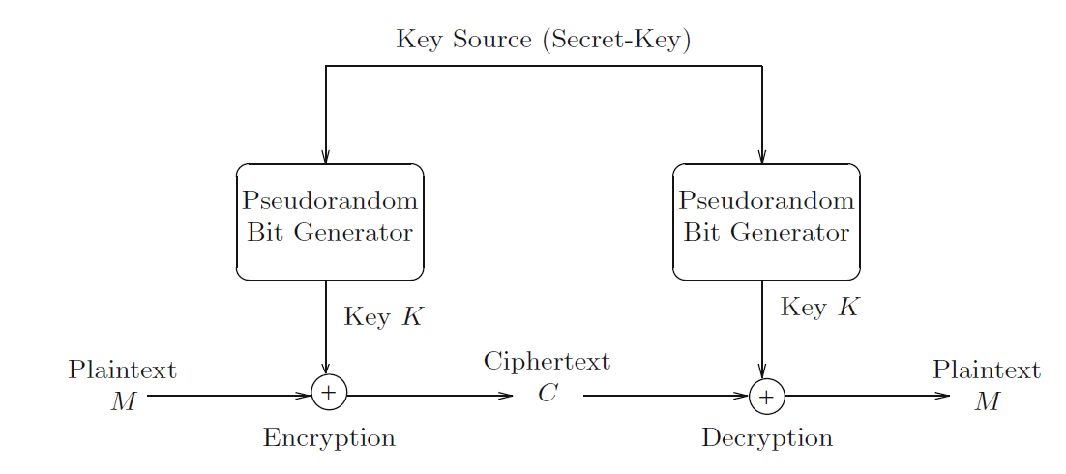
Stream Cipher (5 of 8)

Slide 34
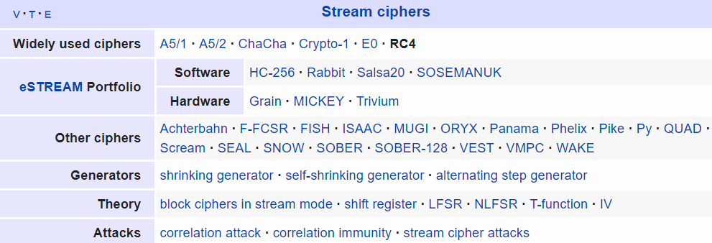
Stream Cipher (6 of 8)
Rivest Cipher 4
https://en.wikipedia.org/wiki/RC4
Chaotic-based cryptosystem
https://en.wikipedia.org/wiki/List_of_chaotic_maps

Slide 35
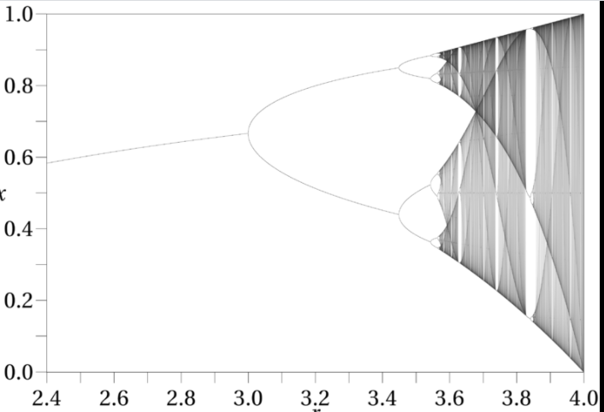

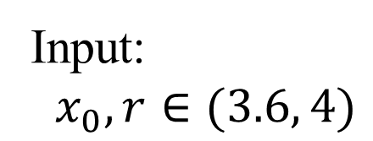

Stream Cipher (7 of 8)
Chaotic-based cryptosystem
Example:
Logistic map
Input:
$x_{0}, r∈(3.6, 4)$
Output:
$${ x}_{1},x_{2},x_{3},…x_{n},….$$
$$0<x_{i}<1$$

Slide 36

Stream Cipher (8 of 8)
Chaotic-based crypto system
Chaotic maps
Image$,$ Video

Slide 37
Outline
Stream Cipher
Block cipher
Data Encryption Standard (DES)
Advanced Encryption Standard (AES)
Some other ciphers
Searchable encryption
Notes:
Cipher=a secret system of writing;

Slide 38
Block Cipher
A block of plaintext is treated as a whole and used to produce a ciphertext block of equal length
Typically a block size of 64 or 128 bits is used
As with a stream cipher, the two users share a symmetric encryption key
The majority of network-based symmetric cryptographic applications make use of block ciphers
Notes:
A block cipher is one in which a block of plaintext is treated as a whole
and used to produce a ciphertext block of equal length. Typically, a block size of
64 or 128 bits is used. As with a stream cipher, the two users share a symmetric
encryption key (Figure 4.1b). Using some of the modes of operation explained
in Chapter 7, a block cipher can be used to achieve the same effect as a stream
cipher.
Far more effort has gone into analyzing block ciphers. In general, they seem
applicable to a broader range of applications than stream ciphers. The vast majority
of network-based symmetric cryptographic applications make use of block
ciphers. Accordingly, the concern in this chapter, and in our discussions throughout
the book of symmetric encryption, will primarily focus on block ciphers.

Slide 39
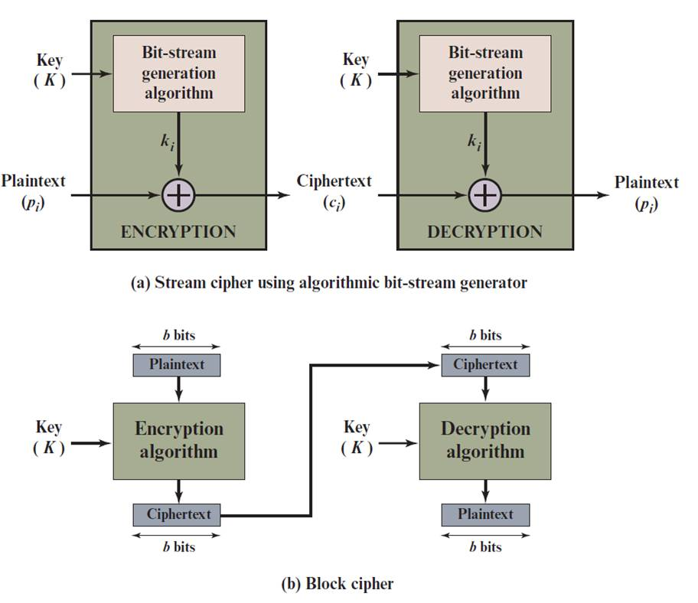
Stream Cipher Vs. Block Cipher
Notes:
Examples of stream and block ciphers.

Slide 40

Encryption and Decryption Tables for Substitution Cipher
$$b_{1}b_{2}b_{3}b_{4}$$
Plaintext | Ciphertext
0000 | 1110
0001 | 0100
0010 | 1101
0011 | 0001
0100 | 0010
0101 | 1111
0110 | 1011
0111 | 1000
1000 | 0011
1001 | 1010
1010 | 0110
1011 | 1100
1100 | 0101
1101 | 1001
1110 | 0000
1111 | 0111
Ciphertext | Plaintext
0000 | 1110
0001 | 0011
0010 | 0100
0011 | 1000
0100 | 0001
0101 | 1100
0110 | 1010
0111 | 1111
1000 | 0111
1001 | 1101
1010 | 1001
1011 | 0110
1100 | 1011
1101 | 0010
1110 | 0000
1111 | 0101
Notes:
The encryption and decryption mappings can be defined
by a tabulation, as shown in Table 4.1. This is the most general form of block cipher
and can be used to define any reversible mapping between plaintext and ciphertext.
Feistel refers to this as the ideal block cipher, because it allows for the maximum
number of possible encryption mappings from the plaintext block [FEIS75].

Slide 41
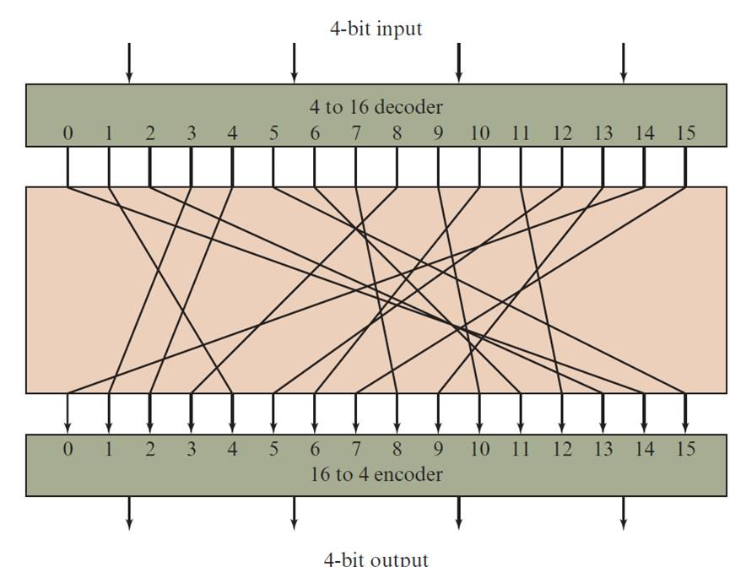


Block Substitution
$$b_{1}b_{2}b_{3}b_{4}$$
4-bits block substitution
0000
$$c_{1}c_{2}c_{3}c_{4}$$
1111
Notes:
A block cipher operates on a plaintext block of n bits to produce a ciphertext
block of n bits. There are 2^{n} possible different plaintext blocks and, for the
encryption to be reversible (i.e., for decryption to be possible), each must produce
a unique ciphertext block. Such a transformation is called reversible, or nonsingular.
Figure 4.2 illustrates the logic of a general substitution cipher for n = 4.
A 4-bit input produces one of 16 possible input states, which is mapped by the substitution
cipher into a unique one of 16 possible output states, each of which is represented
by 4 ciphertext bits.

Slide 42


Block Substitution
How many possible substitutions for a block n-bit?
$$b_{1}b_{2}b_{3}….b_{n}$$
$$c_{1}c_{2}c_{3}….c_{n}$$

Slide 43
Feistel Cipher
Feistel proposed the use of a cipher that alternates substitutions and permutations
Substitutions
Each plaintext element or group of elements is uniquely replaced by a corresponding ciphertext element or group of elements
Permutation
No elements are added or deleted or replaced in the sequence, rather the order in which the elements appear in the sequence is changed
Is a practical application of a proposal by Claude Shannon to develop a product cipher that alternates confusion and diffusion functions
Is the structure used by many significant symmetric block ciphers currently in use
Feistel, H. (1973). Cryptography and computer privacy. Scientific american, 228(5), 15-23.
Notes:
Feistel proposed [FEIS73] that we can approximate the ideal block cipher by utilizing
the concept of a product cipher, which is the execution of two or more simple ciphers
in sequence in such a way that the final result or product is cryptographically stronger
than any of the component ciphers. The essence of the approach is to develop a block
cipher with a key length of k bits and a block length of n bits, allowing a total of 2^{k}
possible transformations, rather than the 2^{n} ! transformations available with the ideal
block cipher.
In particular, Feistel proposed the use of a cipher that alternates substitutions
and permutations, where these terms are defined as follows:
• Substitution: Each plaintext element or group of elements is uniquely replaced
by a corresponding ciphertext element or group of elements.
• Permutation: A sequence of plaintext elements is replaced by a permutation
of that sequence. That is, no elements are added or deleted or replaced in the
sequence, rather the order in which the elements appear in the sequence is
changed.
In fact, Feistel’s is a practical application of a proposal by Claude Shannon
to develop a product cipher that alternates confusion and diffusion functions
[SHAN49]. We look next at these concepts of diffusion and confusion and then
present the Feistel cipher. But first, it is worth commenting on this remarkable fact:
The Feistel cipher structure, which dates back over a quarter century and which, in
turn, is based on Shannon’s proposal of 1945, is the structure used by many significant
symmetric block ciphers currently in use.
In particular, the Feistel structure
is used for Triple Data Encryption Algorithm (TDEA), which is one of the two
encryption algorithms (along with AES), approved for general use by the National
Institute of Standards and Technology (NIST). The Feistel structure is also used for
several schemes for format-preserving encryption, which have recently come into
prominence. In addition, the Camellia block cipher is a Feistel structure; it is one
of the possible symmetric ciphers in TLS and a number of other Internet security
protocols. Both TDEA and format-preserving encryption are covered in Chapter 7.

Slide 44
Diffusion and Confusion
Terms introduced by Claude Shannon to capture the two basic building blocks for any cryptographic system
Shannon’s concern was to thwart cryptanalysis based on statistical analysis
Diffusion
The statistical structure of the plaintext is dissipated into long-range statistics of the ciphertext
This is achieved by having each plaintext digit affect the value of many ciphertext digits
Confusion
Seeks to make the relationship between the statistics of the ciphertext and the value of the encryption key as complex as possible
Even if the attacker can get some handle on the statistics of the ciphertext, the way in which the key was used to produce that ciphertext is so complex as to make it difficult to deduce the key
Notes:
The terms diffusion and confusion were introduced by
Claude Shannon to capture the two basic building blocks for any cryptographic
system [SHAN49]. Shannon’s concern was to thwart cryptanalysis based on statistical
analysis. The reasoning is as follows. Assume the attacker has some knowledge
of the statistical characteristics of the plaintext. For example, in a human-readable
message in some language, the frequency distribution of the various letters may be
known. Or there may be words or phrases likely to appear in the message (probable
words). If these statistics are in any way reflected in the ciphertext, the cryptanalyst
may be able to deduce the encryption key, part of the key, or at least a set of keys
likely to contain the exact key. In what Shannon refers to as a strongly ideal cipher,
all statistics of the ciphertext are independent of the particular key used. The arbitrary
substitution cipher that we discussed previously (Figure 4.2) is such a cipher,
but as we have seen, it is impractical.
Other than recourse to ideal systems, Shannon suggests two methods for
frustrating statistical cryptanalysis: diffusion and confusion. In diffusion, the
statistical structure of the plaintext is dissipated into long-range statistics of the
ciphertext. This is achieved by having each plaintext digit affect the value of many
ciphertext digits; generally, this is equivalent to having each ciphertext digit be
affected by many plaintext digits.
Every block cipher involves a transformation of a block of plaintext into a
block of ciphertext, where the transformation depends on the key. The mechanism
of diffusion seeks to make the statistical relationship between the plaintext and
ciphertext as complex as possible in order to thwart attempts to deduce the key. On
the other hand, confusion seeks to make the relationship between the statistics of
the ciphertext and the value of the encryption key as complex as possible, again to
thwart attempts to discover the key. Thus, even if the attacker can get some handle
on the statistics of the ciphertext, the way in which the key was used to produce that
ciphertext is so complex as to make it difficult to deduce the key. This is achieved by
the use of a complex substitution algorithm. In contrast, a simple linear substitution
function would add little confusion.
As [ROBS95b] points out, so successful are diffusion and confusion in capturing
the essence of the desired attributes of a block cipher that they have become the
cornerstone of modern block cipher design.

Slide 45
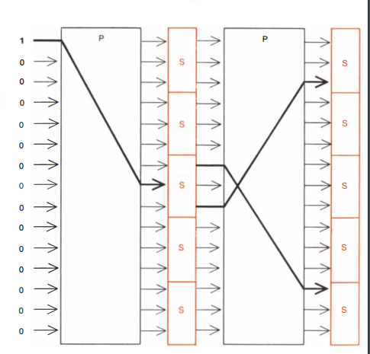
Feistel Cipher
Notes:
The left-hand side of Figure 4.3 depicts the structure
proposed by Feistel. The inputs to the encryption algorithm are a plaintext block of
length 2w bits and a key K . The plaintext block is divided into two halves, LE₀ and RE₀ .
The two halves of the data pass through n rounds of processing and then combine to
produce the ciphertext block. Each round i has as inputs LE_{i-1} and RE_{i-1} derived from
the previous round, as well as a subkey K_{i} derived from the overall K . In general,
the subkeys K_{i} are different from K and from each other. In Figure 4.3, 16 rounds
are used, although any number of rounds could be implemented.
All rounds have the same structure. A substitution is performed on the left half
of the data. This is done by applying a round function F to the right half of the data
and then taking the exclusive-OR of the output of that function and the left half of the
data. The round function has the same general structure for each round but is parameterized
by the round subkey K_{i} . Another way to express this is to say that F is a function
of right-half block of w bits and a subkey of y bits, which produces an output value
of length w bits: F (RE_{i} , K_{i+1} ). Following this substitution, a permutation is performed
that consists of the interchange of the two halves of the data. This structure is a particular
form of the substitution-permutation network (SPN) proposed by Shannon.

Slide 46
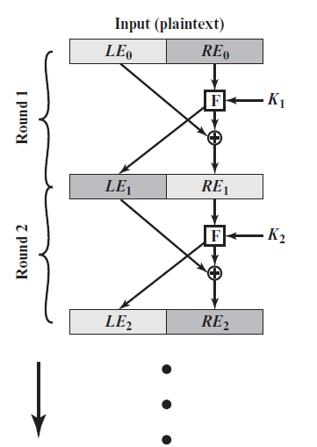
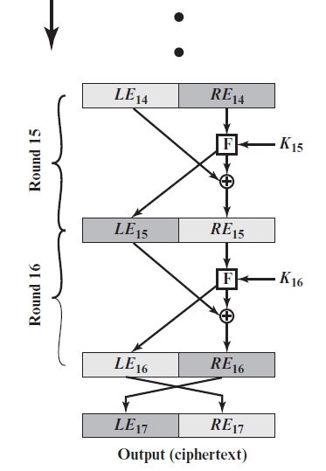
Feistel Encryption and Decryption (16 rounds)
P.126
Notes:
The left-hand side of Figure 4.3 depicts the structure
proposed by Feistel. The inputs to the encryption algorithm are a plaintext block of
length 2w bits and a key K . The plaintext block is divided into two halves, LE₀ and RE₀ .
The two halves of the data pass through n rounds of processing and then combine to
produce the ciphertext block. Each round i has as inputs LE_{i-1} and RE_{i-1} derived from
the previous round, as well as a subkey K_{i} derived from the overall K . In general,
the subkeys K_{i} are different from K and from each other. In Figure 4.3, 16 rounds
are used, although any number of rounds could be implemented.
All rounds have the same structure. A substitution is performed on the left half
of the data. This is done by applying a round function F to the right half of the data
and then taking the exclusive-OR of the output of that function and the left half of the
data. The round function has the same general structure for each round but is parameterized
by the round subkey K_{i} . Another way to express this is to say that F is a function
of right-half block of w bits and a subkey of y bits, which produces an output value
of length w bits: F (RE_{i} , K_{i+1} ). Following this substitution, a permutation is performed
that consists of the interchange of the two halves of the data. This structure is a particular
form of the substitution-permutation network (SPN) proposed by Shannon.

Slide 47
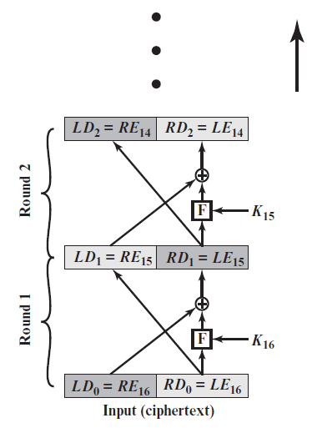
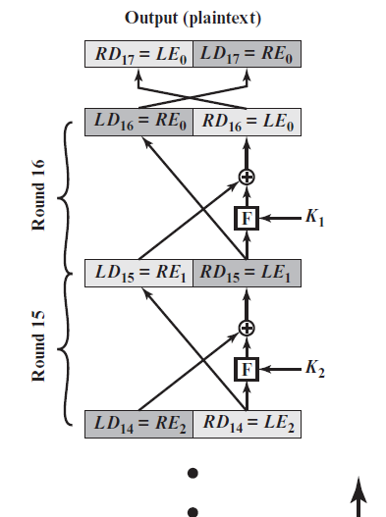
Feistel Encryption and Decryption (16 rounds)

Slide 48
The Feistel Cipher Scheme (FCS)
Divide M into blocks of 2l-bits long (pad the last block if needed)
Use only the XOR and Substitution operations
Generate n sub-keys of a fixed length from the encryption key K: K₁,…,K_{n}
Divide a 2l-bit block input into two parts: L₀ and R₀, both of size l (the suffix and prefix of the block, respectively)
Perform a substitution function F on an l-bit input string and a sub-key to produce an l-bit output
Encryption and decryption each executes n rounds of the same sequence of operations

Slide 49
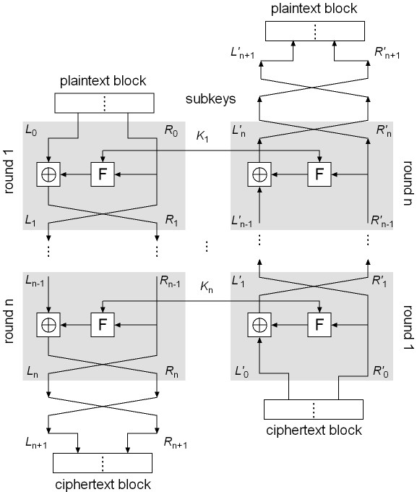
FCS Encryption and Decryption
FCS Encryption
Let M = L₀R₀; execute the following operations in round i, i = 1, …, n:
L_{i} = R_{i–1}
R_{i} = L_{i–1} ⊕ F(R_{i–1}, K_{i})
Let L_{n+1} = R_{n}, R_{n+1} = L_{n} and C = L_{n+1}R_{n+1}
FCS Decryption
Symmetrical to encryption, with sub-keys in reverse order
Rewrite C as C = L’₀R’₀
Execute the following in round i (i = 1, …, n):
L’_{i} = R’_{i–1}
R’_{i} = L’_{i–1} ⊕ F(R’_{i–1}, K’_{n–i+1})
Let L’_{n+1} = R’_{n}, R’_{n+1} = L’_{n}
We will show that M = L’_{n+1}R’_{n+1}
Encryption
Start
Decryption
Start

Slide 50
Proof of FCS decryption
Will show that C = L_{n+1}R_{n+1} = L’₀R’₀ is transformed back to M = L₀R₀ by the FCS Decryption algorithm
Prove by induction the following equalities:
(1) L’_{i} = R_{n–i} (2) R’_{i} = L_{n–i}
Basis: L₀’ = L_{n+1} = R_{n}, R₀’ = R_{n+1} = L_{n}; (1) and (2) hold
Hypothesis: Assume when i ≤ n:
L_{i–1}’ = R_{n–(i–1)} R_{i–1}’ = L_{n–(i–1)}
Induction step:
L’_{i} = R’_{i–1} (by decrypt. alg.) = L_{n–i+1} (by hypothesis) = R_{n–i} (by encrypt. alg.)
Hence (1) is true
R’_{i} = L’_{i–1} ⊕ F(R’_{i–1}, K_{n–i+1})
= R_{n–(i+1)} ⊕ F(L_{n–(i+1)}, K_{n–i+1})
= [L_{n–i} ⊕ F(R_{n–i}, K_{n–i+1})] ⊕ F(R_{n–i}, K_{n–i+1})
= L_{n–i}
Hence (2) true

Slide 51
Feistel Cipher Design Features (1 of 2)
Block size
Larger block sizes mean greater security but reduced encryption/decryption speed for a given algorithm
Key size
Larger key size means greater security but may decrease encryption/decryption speeds
Number of rounds
The essence of the Feistel cipher is that a single round offers inadequate security but that multiple rounds offer increasing security
Subkey generation algorithm
Greater complexity in this algorithm should lead to greater difficulty of cryptanalysis
Notes:
The exact realization of a Feistel network depends on the choice of the following
parameters and design features:
• Block size: Larger block sizes mean greater security (all other things being
equal) but reduced encryption/decryption speed for a given algorithm. The
greater security is achieved by greater diffusion. Traditionally, a block size of
64 bits has been considered a reasonable tradeoff and was nearly universal in
block cipher design. However, the new AES uses a 128-bit block size.
• Key size: Larger key size means greater security but may decrease encryption/
decryption speed. The greater security is achieved by greater resistance to
brute-force attacks and greater confusion. Key sizes of 64 bits or less are now
widely considered to be inadequate, and 128 bits has become a common size.
• Number of rounds: The essence of the Feistel cipher is that a single round
offers inadequate security but that multiple rounds offer increasing security.
A typical size is 16 rounds.
• Subkey generation algorithm: Greater complexity in this algorithm should
lead to greater difficulty of cryptanalysis.
• Round function F: Again, greater complexity generally means greater resistance
to cryptanalysis.
There are two other considerations in the design of a Feistel cipher:
• Fast software encryption/decryption: In many cases, encryption is embedded in
applications or utility functions in such a way as to preclude a hardware implementation.
Accordingly, the speed of execution of the algorithm becomes a
concern.
• Ease of analysis: Although we would like to make our algorithm as difficult as
possible to cryptanalyze, there is great benefit in making the algorithm easy to
analyze. That is, if the algorithm can be concisely and clearly explained, it is
easier to analyze that algorithm for cryptanalytic vulnerabilities and therefore
develop a higher level of assurance as to its strength. DES, for example, does
not have an easily analyzed functionality.

Slide 52
Feistel Cipher Design Features (2 of 2)
Round function F
Greater complexity generally means greater resistance to cryptanalysis
Fast software encryption/decryption
In many cases, encrypting is embedded in applications or utility functions in such a way as to preclude a hardware implementation; accordingly, the speed of execution of the algorithm becomes a concern
Ease of analysis
If the algorithm can be concisely and clearly explained, it is easier to analyze that algorithm for cryptanalytic vulnerabilities and therefore develop a higher level of assurance as to its strength
Notes:
The exact realization of a Feistel network depends on the choice of the following
parameters and design features:
• Block size: Larger block sizes mean greater security (all other things being
equal) but reduced encryption/decryption speed for a given algorithm. The
greater security is achieved by greater diffusion. Traditionally, a block size of
64 bits has been considered a reasonable tradeoff and was nearly universal in
block cipher design. However, the new AES uses a 128-bit block size.
• Key size: Larger key size means greater security but may decrease encryption/
decryption speed. The greater security is achieved by greater resistance to
brute-force attacks and greater confusion. Key sizes of 64 bits or less are now
widely considered to be inadequate, and 128 bits has become a common size.
• Number of rounds: The essence of the Feistel cipher is that a single round
offers inadequate security but that multiple rounds offer increasing security.
A typical size is 16 rounds.
• Subkey generation algorithm: Greater complexity in this algorithm should
lead to greater difficulty of cryptanalysis.
• Round function F: Again, greater complexity generally means greater resistance
to cryptanalysis.
There are two other considerations in the design of a Feistel cipher:
• Fast software encryption/decryption: In many cases, encryption is embedded in
applications or utility functions in such a way as to preclude a hardware implementation.
Accordingly, the speed of execution of the algorithm becomes a
concern.
• Ease of analysis: Although we would like to make our algorithm as difficult as
possible to cryptanalyze, there is great benefit in making the algorithm easy to
analyze. That is, if the algorithm can be concisely and clearly explained, it is
easier to analyze that algorithm for cryptanalytic vulnerabilities and therefore
develop a higher level of assurance as to its strength. DES, for example, does
not have an easily analyzed functionality.

Slide 53
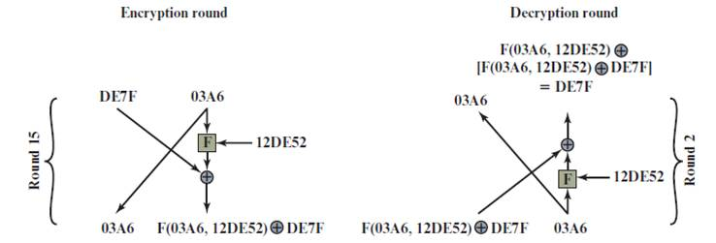
Feistel Example
Notes:
The process of decryption with a Feistel cipher
is essentially the same as the encryption process. The rule is as follows: Use the
ciphertext as input to the algorithm, but use the subkeys K_{i} in reverse order. That
is, use K_{n} in the first round, K_{n-1} in the second round, and so on, until K₁ is used in
the last round. This is a nice feature, because it means we need not implement two
different algorithms; one for encryption and one for decryption.

Slide 54
Outline
Stream Cipher
Block cipher
Data Encryption Standard (DES)
Advanced Encryption Standard (AES)
Some other ciphers
Searchable encryption
Notes:
Cipher=a secret system of writing;

Slide 55
Data Encryption Standard (DES)
Issued in 1977 by the National Bureau of Standards (now NIST) as Federal Information Processing Standard 46
Was the most widely used encryption scheme until the introduction of the Advanced Encryption Standard (AES) in 2001
Algorithm itself is referred to as the Data Encryption Algorithm (DEA)
Data are encrypted in 64-bit blocks using a 56-bit key
The algorithm transforms 64-bit input in a series of steps into a 64-bit output
The same steps, with the same key, are used to reverse the encryption
Notes:
Until the introduction of the Advanced Encryption Standard (AES) in 2001, the
Data Encryption Standard (DES) was the most widely used encryption scheme.
DES was issued in 1977 by the National Bureau of Standards, now the National
Institute of Standards and Technology (NIST), as Federal Information Processing
Standard 46 (FIPS PUB 46). The algorithm itself is referred to as the Data
Encryption Algorithm (DEA). For DEA, data are encrypted in 64-bit blocks using
a 56-bit key. The algorithm transforms 64-bit input in a series of steps into a 64-bit
output. The same steps, with the same key, are used to reverse the encryption.
Over the years, DES became the dominant symmetric encryption algorithm,
especially in financial applications. In 1994, NIST reaffirmed DES for federal use
for another five years; NIST recommended the use of DES for applications other
than the protection of classified information. In 1999, NIST issued a new version
of its standard (FIPS PUB 46-3) that indicated that DES should be used only for
legacy systems and that triple DES (which in essence involves repeating the DES
algorithm three times on the plaintext using two or three different keys to produce
the ciphertext) be used. We study triple DES in Chapter 7. Because the underlying
encryption and decryption algorithms are the same for DES and triple DES, it
remains important to understand the DES cipher. This section provides an overview.
For the interested reader, Appendix C provides further detail.

Slide 56
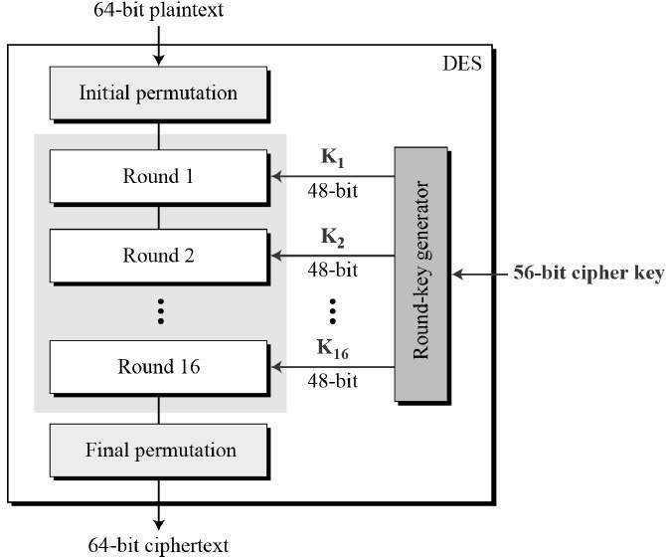
DES Encryption Algorithm
Notes:
The overall scheme for DES encryption is illustrated in Figure 4.5. As with any encryption
scheme, there are two inputs to the encryption function: the plaintext to be
encrypted and the key. In this case, the plaintext must be 64 bits in length and the
key is 56 bits in length.
Looking at the left-hand side of the figure, we can see that the processing
of the plaintext proceeds in three phases. First, the 64-bit plaintext passes through
an initial permutation (IP) that rearranges the bits to produce the permuted input .
This is followed by a phase consisting of sixteen rounds of the same function, which
involves both permutation and substitution functions. The output of the last (sixteenth)
round consists of 64 bits that are a function of the input plaintext and the
key. The left and right halves of the output are swapped to produce the preoutput .
Finally, the preoutput is passed through a permutation [IP ⁻¹ ] that is the inverse of
the initial permutation function, to produce the 64-bit ciphertext. With the exception
of the initial and final permutations, DES has the exact structure of a Feistel
cipher, as shown in Figure 4.3.
The right-hand portion of Figure 4.5 shows the way in which the 56-bit key is
used. Initially, the key is passed through a permutation function. Then, for each of
the sixteen rounds, a subkey (K_{i} ) is produced by the combination of a left circular
shift and a permutation. The permutation function is the same for each round, but a
different subkey is produced because of the repeated shifts of the key bits.
As with any Feistel cipher, decryption uses the same algorithm as encryption,
except that the application of the subkeys is reversed. Additionally, the initial and
final permutations are reversed.

Slide 57
DES Sub-Key Generation
The block size of DES is 64 bits and the encryption key is 56 bits, which is represented as a 64-bit string K = k₁ k₂ … k₆₄
DES uses 16 rounds of iterations with 16 sub-keys
Sub-key generation:
Remove the 8i-th bit (i = 1, 2, …, 8) from K
Perform an initial permutation on the remaining 56 bits of K, denoted by IP_{key}(K)
Split this 56-bit key into two pieces: U₀V₀, both with 28 bits
Perform Left Circular Shift on U₀ and V₀ a defined number of times, producing U_{i}V_{i}:
U_{i} = LS_{z(i)} (U_{i–1}), V_{i} = LS_{z(i)} (V_{i–1})
Permute the resulting U_{i}V_{i} using a defined compress permutation, resulting in a 48-bit string as a sub-key, denoted by K_{i}
K_{i} = P_{key} (U_{i} V_{i} )
https://www.geeksforgeeks.org/data-encryption-standard-des-set-1/

Slide 58
DES Substitution Boxes
The DES substitution function F is defined below:
F(R_{i–1}, K_{i}) = P(S(EP(R_{i–1}) ⊕ K_{i})), i = 1,…,16
First, permute R_{i} using EP(R_{i}) to produce a 48-bit string x
Next, XOR x with the 48-bit sub key K_{i} to produce a 48-bit string y
Function S turns y into a 32-bits string z, using eight 4x16 special matrices, called S-boxes
Each entry in an S-box is a 4-bit string
Break y into 8 blocks, each with 6-bits
Use the i^{th} matrix on the i^{th} block b₁b₂b₃b₄b₅b₆
Let b₁b₆ be the row number, and b₂b₃b₄b₅ the column number, and return the corresponding entry
Each 6-bit block is turned to a 4-bit string, resulting in a 32-bit string z
Finally, permute z using P to produce the result of DES’s F function
This result, XOR’d with L_{i–1}, is R_{i}
https://en.wikipedia.org/wiki/DES_supplementary_material

Slide 59
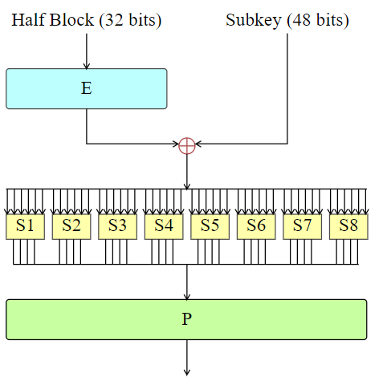
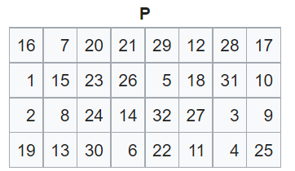
DES function F(R_{i–1}, K_{i})
F(R_{i–1}, K_{i}) = P(S(EP(R_{i–1}) ⊕ K_{i})), i = 1,…,16
Substitution
Permutation

Slide 60
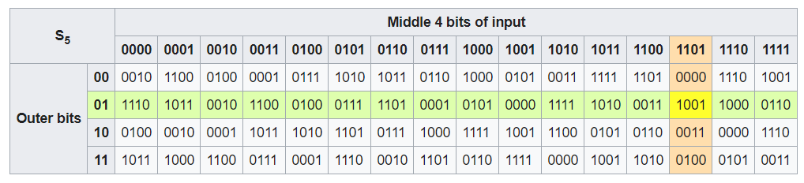
DES Substitution Boxes
Input: “011011”
Output: “1001”

Slide 61
DES encryption steps
Rewrite IP(M) = L₀R₀, where |L₀| = |R₀| =32
For i = 1, 2, …, 16, execute the following operations in order:
L_{i} = R_{i-1}
R_{i} = L_{i-1} ⊕ F(R_{i-1}, K_{i})
Let C = IP⁻¹(R₁₆L₁₆).

Slide 62
Is DES good enough?
Security strength of DES
Number of rounds
Length of encryption key
Construction of the substitute function
DES was used up to the 1990’s.
People began to take on the DES Challenges to crack DES
Only uses 56-bit keys = 2⁵⁶ ~ 7.2× 10¹⁶ keys
Brute-force will work with current technology
In 1997 on Internet in a few months
In 1998 on dedicated h/w (EFF) in a few days
In 1999 above combined in 22 hours

Slide 63
What to Do Next?
Start over
New standards begin to be looked into
On the other hand, can we extend the use of DES?
Notes:
Start over =Start again

Slide 64
Block Cipher Design Principles
The greater the number of rounds, the more difficult it is to perform cryptanalysis
In general, the criterion should be that the number of rounds is chosen so that known cryptanalytic efforts require greater effort than a simple brute-force key search attack
If DES had 15 or fewer rounds, differential cryptanalysis would require less effort than a brute-force key search
Notes:
The cryptographic strength of a Feistel cipher derives from three aspects of the
design: the number of rounds, the function F, and the key schedule algorithm. Let
us look first at the choice of the number of rounds.
The greater the number of rounds, the more difficult it is to perform cryptanalysis,
even for a relatively weak F. In general, the criterion should be that the
number of rounds is chosen so that known cryptanalytic efforts require greater
effort than a simple brute-force key search attack. This criterion was certainly used
in the design of DES. Schneier [SCHN96] observes that for 16-round DES, a differential
cryptanalysis attack is slightly less efficient than brute force: The differential
cryptanalysis attack requires 2^{55.1} operations, whereas brute force requires 2⁵⁵ . If
DES had 15 or fewer rounds, differential cryptanalysis would require less effort
than a brute-force key search.
This criterion is attractive, because it makes it easy to judge the strength of
an algorithm and to compare different algorithms. In the absence of a cryptanalytic
breakthrough, the strength of any algorithm that satisfies the criterion can be
judged solely on key length.

Slide 65
Block Cipher Design Principles
The heart of a Feistel block cipher is the function F
The more nonlinear F, the more difficult any type of cryptanalysis will be
The SAC and BIC criteria appear to strengthen the effectiveness of the confusion function
The algorithm should have good avalanche properties
Strict avalanche criterion (SAC)
States that any output bit j of an S-box should change with probability 1/2 when any single input bit i is inverted for all i , j
Bit independence criterion (BIC)
States that output bits j and k should change independently when any single input bit i is inverted for all i , j , and k
Notes:
The heart of a Feistel block cipher is the function F, which provides the element
of confusion in a Feistel cipher. Thus, it must be difficult to “unscramble” the
substitution performed by F. One obvious criterion is that F be nonlinear, as we
discussed previously. The more nonlinear F, the more difficult any type of cryptanalysis
will be. There are several measures of nonlinearity, which are beyond
the scope of this book. In rough terms, the more difficult it is to approximate F
by a set of linear equations, the more nonlinear F is.
Several other criteria should be considered in designing F. We would like the
algorithm to have good avalanche properties. Recall that, in general, this means that
a change in one bit of the input should produce a change in many bits of the output.
A more stringent version of this is the strict avalanche criterion (SAC) [WEBS86],
which states that any output bit j of an S-box (see Appendix C for a discussion of
S-boxes) should change with probability 1/2 when any single input bit i is inverted
for all i , j . Although SAC is expressed in terms of S-boxes, a similar criterion could
be applied to F as a whole. This is important when considering designs that do not
include S-boxes.
Another criterion proposed in [WEBS86] is the bit independence criterion
(BIC), which states that output bits j and k should change independently when any
single input bit i is inverted for all i , j , and k . The SAC and BIC criteria appear to
strengthen the effectiveness of the confusion function.

Slide 66
Block Cipher Design Principles
With any Feistel block cipher, the key is used to generate one subkey for each round
In general, we would like to select subkeys to maximize the difficulty of deducing individual subkeys and the difficulty of working back to the main key
It is suggested that, at a minimum, the key schedule should guarantee key/ciphertext Strict Avalanche Criterion and Bit Independence Criterion
Notes:
With any Feistel block cipher, the key is used to generate one subkey for each
round. In general, we would like to select subkeys to maximize the difficulty of
deducing individual subkeys and the difficulty of working back to the main key. No
general principles for this have yet been promulgated.
Adams suggests [ADAM94] that, at minimum, the key schedule should
guarantee key/ciphertext Strict Avalanche Criterion and Bit Independence
Criterion.

